Slide 1
Advanced Operating Systems:
Linux Memory Management
Yi-Chiun Fang
Electrical Engineering Dept.

Slide 2
Outline
Segmentation
Paging
  Extended Paging
  PAE
  Reverse Mapping
Memory Zones
Page Frame Management
  The Buddy System Algorithm
  The Zone Allocator
  The Slab Allocator
  Noncontiguous Memory Area Management
Conclusion
Using Linux Kernel version 2.6.20.4

Slide 3
Types of Memory Addresses
Logical address
  Realization of the segmented architecture
Linear address (virtual address)
  32-bit unsigned int used to assign up to 4GB of memory (0x00000000 ~ 0xffffffff)
Physical address
  32-bit / 36-bit unsigned int representing the electrical signals sent to the memory bus
logical addr
linear addr
physical addr
Segmented Unit
Paging Unit

Slide 4
Segmentation
logical addr
linear addr
Segmented Unit
x86 systems use segment-based address
Logical address:
segment selector : offset
(16-bit) (32-bit)
Segment: a logically-contiguous partition of a process's address space that has its own protection policy
  Splits the range of memory addresses into multiple contiguous segments
  Operations based on registers:
  faster and consumes less memory than page tables

Slide 5
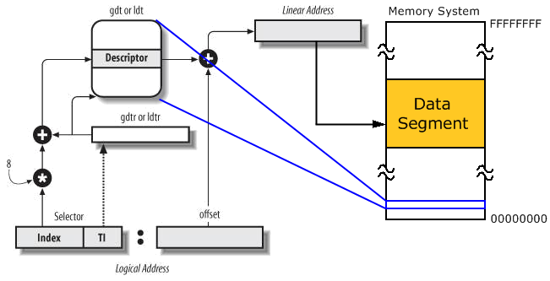
Segmentation in x86 Hardware
Understanding the Linux Kernel, 3rd Ed.

Slide 6
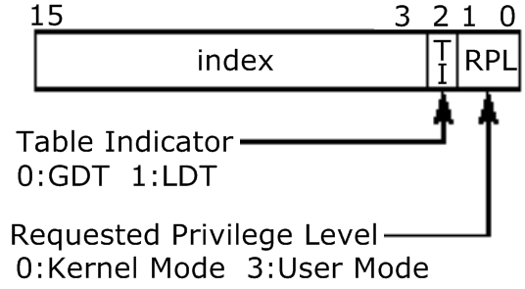
Segment Selector
6 Segmentation Registers
  cs: Code Segment Register
  ss: Stack Segment Register
  ds: Data Segment Register
  es, fs, gs: General Purpose Registers

Slide 7
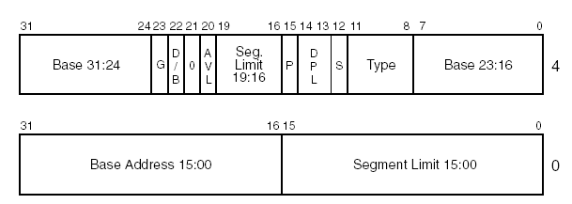
Segment Descriptor
http://futura.disca.upv.es/~eso/es/t2-arquitectura/segment_descriptor.png
Base: linear address of the first
byte of the segment
Limit: segment length
S: system flag (e.g. LDT)
Type: segment type
G: Granularity flag
D/B: contains code / data
AVL: ignored
P: Present flag (always 1)
DPL: Descriptor Privilege Level

Slide 8
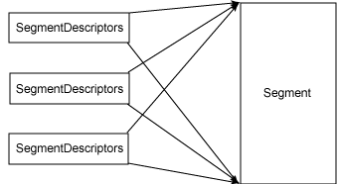
Segmentation in Linux
All processes share the same set of linear addresses
Linux prefers paging to segmentation
  Simpler memory management
  Portability:
  some architectures have very little support for segmentation
Linux 2.6 uses
segmentation only
when required by
the x86 architecture
http://www-128.ibm.com/developerworks/linux/library/l-memmod/fig2.gif

Slide 9
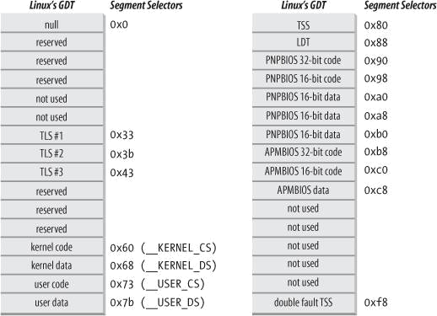
Linux’s Global Descriptor Table
Task State Segment:
context information
Local Descriptor Table:
usually shared by all processes
Processes in Kernel Mode
Processes in User Mode
Understanding the Linux Kernel, 3rd Ed.

Slide 10
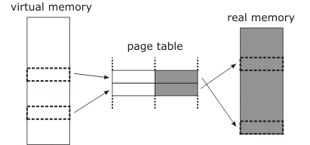
Paging
linear addr
physical addr
Paging Unit
The paging unit thinks of all RAM as partitioned into fixed-length page frames
Linear addresses are grouped in fixed-length intervals called pages
Page tables: the data structures stored in memory; map linear to physical addresses
Better supported by processors
Good management
for swapping,
memory sharing,
and sparse address
spaces
http://www.ualberta.ca/CNS/RESEARCH/LinuxClusters/images/mem/figure1.png

Slide 11
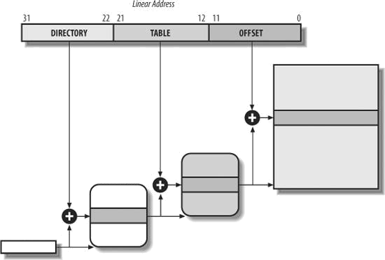
Paging in x86 Hardware
Enabled by setting the PG flag of register cr0
32-bit x86 processors normally use 4 KB pages
2-level paging:
reduces the
amount of RAM
required for per-
process Page Tables
  Allocate RAM for a
  Page Table only when
  the process needs it
10-bit
10-bit
12-bit
Page
4 KB
1024 entries
1024 entries
Page Table
Page Directory
cr3
Understanding the Linux Kernel, 3rd Ed.

Slide 12
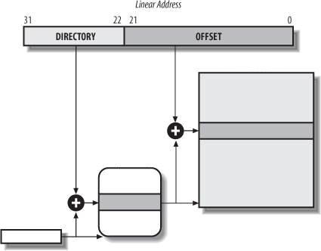
Extended Paging
Used to translate large contiguous linear address ranges into corresponding physical ones
10-bit
22-bit
Page
4MB
Page Directory
cr3
Understanding the Linux Kernel, 3rd Ed.

Slide 13
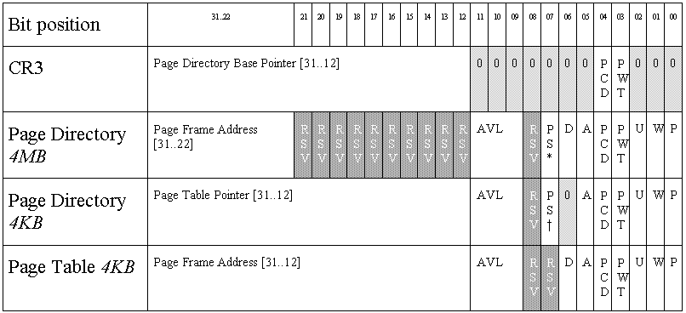
CR3 / PDE / PTE Format
Present
Read/Write
page directories and page tables start in memory on page (4K) boundaries
User/Supervisor
Accessed
Dirty
Page Size
http://www.rcollins.org/ddj/May96/Tbl1.gif

Slide 14
Physical Address Extension (PAE)
Enabled by setting the PAE flag of register cr4
The number of address pins on the processor is increased from 32 to 36
  Still 32 bits in the linear address
  Able to address 2³⁶ = 64 GB of RAM
  2²⁴ page frames
  64-bit PTE results in 512 entries in the table
  Page Directory Pointer Table (PDPT) consists of four 64-bit entries

Slide 15
Physical Address Extension (PAE)
Linear Address
31
30
29
21
20
12
11
0
Offset of 4-KB page
Point to 1 of 512 possible entries in Page Table
Point to 1 of 512 possible entries in Page Directory
Point to 1 of 4 possible entries in PDPT
31
30
29
21
20
11
0
Offset of 2-MB page
Point to 1 of 512 possible entries in Page Directory
Point to 1 of 4 possible entries in PDPT

Slide 16
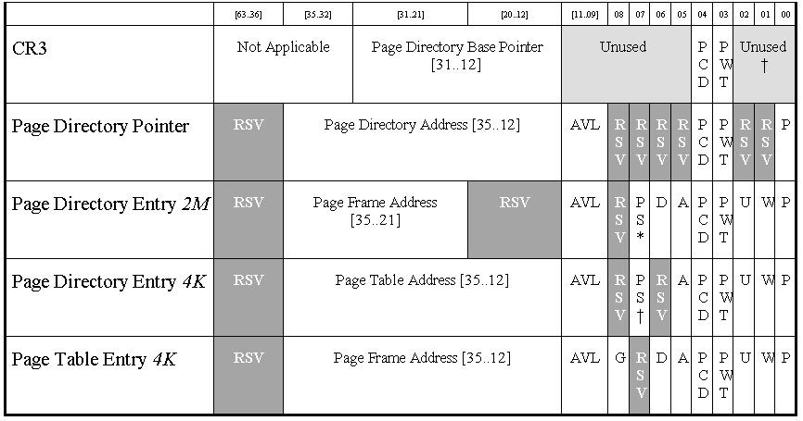
Physical Address Extension (PAE)
Unused
Increased 4 bits
Unchanged
Points to a PDPT
http://www.x86.org/ftp/articles/2mpages/paefig1.gif

Slide 17
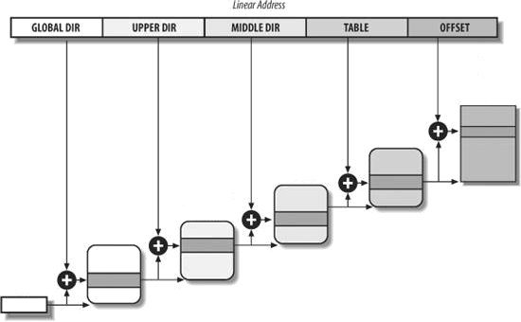
Paging in Linux
Linux uses 4-level paging since version 2.6.11
PUD and PMD fields contain 0 bits for x86_32 architectures
  Both contain 1 entry and perform identical mapping
×
×
PAGE_SHIFT
PMD_SHIFT
Page
Page Table
Page Middle Directory
Page Upper
Directory
Page Global Directory
pte_t
pmd_t
cr3
pud_t
pgd_t
Understanding the Linux Kernel, 3rd Ed.

Slide 18
Paging in Linux
Linux's handling of processes relies heavily on paging
Each process is assigned to a different physical address space
Each process has its own Page Global Directory and its own set of Page Tables
Saves and reloads the cr3 register for process switching

Slide 19
Reverse Mapping
Every single process mapping a particular page must be found before the page is swapped out
  Linux 2.4 used an inefficient mechanism that traversed the page tables for every process
Each physical page has a linked list called a PTE chain that contains pointers to the PTEs of every process currently mapping that page
Downsides: introduces complexity and adds memory overhead

Slide 20
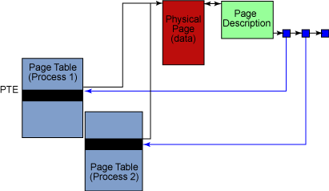
Reverse Mapping
PTE chain
http://www-128.ibm.com/developerworks/linux/library/l-mem26/fig1.gif

Slide 21
Page Descriptor
include/linux/mm_types.h
struct page {
unsigned long flags;
atomic_t _count;
atomic_t _mapcount;
union {
struct {
unsigned long private;
struct address_space *mapping;
};
};
pgoff_t index;
struct list_head lru;
#if defined(WANT_PAGE_VIRTUAL)
void *virtual;
#endif /* WANT_PAGE_VIRTUAL */
};
describes the status of the page
reference count (-1 for a free frame)
# of PTEs that refer to the page frame
available to the kernel component
pointer to the address_space
offset within mapping
holds the next and prev pointers to the
corresponding elements in the LRU lists
kernel virtual address

Slide 22
Memory Zones
Memory nodes are subdivided into 3 zones
ZONE_DMA (<16MB)
  Used for DMA page frames for old ISA-based devices
ZONE_NORMAL (16MB~896MB)
  Includes non-DMA pages with virtual mapping
ZONE_HIGHMEM (>896MB)
  Includes page frames that cannot be directly accessed by the kernel through linear mapping

Slide 23
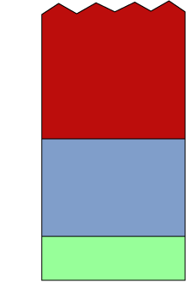
Kernel / User Segment
128MB left for noncontiguous
memory allocation and fix-mapped
linear addresses
Kernel
Mode
0xffffffff
high_memory
kernel-specific data
PAGE_OFFSET
Kernel Segment
1G
0xc0000000
ZONE_HIGHMEM
0xbfffffff
User Segment
3G
896MB
user-level, process-specific data;
every process has its own,
independent user segment
ZONE_NORMAL
16MB
ZONE_DMA
0x00000000
0MB
User
Mode
Kernel
Mode
directly mapped
(linear X -> physical X-PAGE_OFFSET)

Slide 24
Zone Descriptor
include/linux/mmzone.h
blocks of free page frames in the zone (Buddy System)
spinlock protecting the descriptor
data structure for the Per-CPU Page Frame Cache
# of page frames reserved for low-on-memory situations
(atomic memory allocation requests)
zone watermark values (Zone Allocator)
struct zone {
/* Fields commonly accessed
by the page allocator */
unsigned long free_pages;
unsigned long pages_min, pages_low, pages_high;
unsigned long lowmem_reserve[MAX_NR_ZONES];
struct per_cpu_pageset pageset[NR_CPUS];
spinlock_t lock;
struct free_area free_area[MAX_ORDER];
/* Fields commonly accessed by the page reclaim scanner */
# of free pages in the zone
…

Slide 25
Zone Descriptor
include/linux/mmzone.h
…
hash table of wait queues of processes
waiting for one of the pages of the zone
wait_queue_head_t *wait_table;
unsigned long wait_table_hash_nr_entries;
unsigned long wait_table_bits;
struct pglist_data *zone_pgdat;
unsigned long zone_start_pfn;
unsigned long spanned_pages;
unsigned long present_pages;
const char *name;
} ____cacheline_internodealigned_in_smp;
memory node
index of the first page
frame of the zone
"DMA," "Normal," or "HighMem”
Total size of zone in pages,
excluding holes
Total size of zone in pages,
including holes

Slide 26
The Buddy System Algorithm
Deals with external fragmentation
All free page frames are grouped into 11 lists of blocks that contain groups of 1, 2, 4, 8, 16, 32, 64, 128, 256, 512, and 1024 contiguous page frames, respectively
  The physical address of the first page frame of a block is a multiple of the group size
Two blocks are considered buddies if:
  Both blocks have the same size b
  Located in contiguous physical addresses
  The physical address of the first page frame of the first block is a multiple of 2 x b x 2¹²

Slide 27
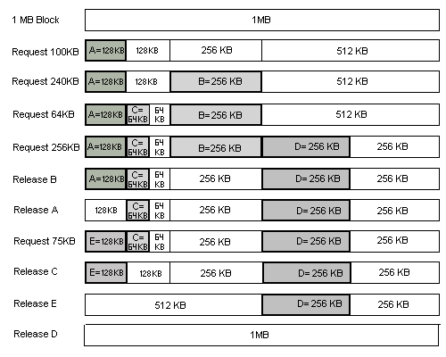
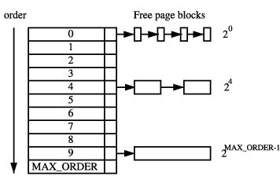
The Buddy System Algorithm
free_area[MAX_ORDER]
cannot coalesce
Understanding the Linux Virtual Memory Manager
include/linux/mmzone.h:
struct free_area {
struct list_head free_list;
unsigned long nr_free;
};
http://bebas.vlsm.org/v06/Kuliah/SistemOperasi/BUKU/img/UC-36-2-BuddySystem.png

Slide 28
__rmqueue( )
mm/page_alloc.c
allocate a free block in a zone
static struct page *__rmqueue(struct zone *zone, unsigned int order)
{
struct free_area * area;
unsigned int current_order;
struct page *page;
for (current_order = order; current_order < MAX_ORDER; ++current_order) {
area = zone->free_area + current_order;
if (list_empty(&area->free_list)) continue;
page = list_entry(area->free_list.next, struct page, lru);
list_del(&page->lru);
rmv_page_order(page);
area->nr_free--;
zone->free_pages -= 1UL << order;
expand(zone, page, order, current_order, area);
return page;
}
return NULL;
}
11

Slide 29
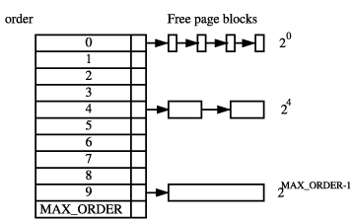
__rmqueue( )
mm/page_alloc.c
allocate a free block in a zone
static struct page *__rmqueue(struct zone *zone, unsigned int order)
{
struct free_area * area;
unsigned int current_order;
struct page *page;
for (current_order = order; current_order < MAX_ORDER; ++current_order) {
area = zone->free_area + current_order;
if (list_empty(&area->free_list)) continue;
page = list_entry(area->free_list.next, struct page, lru);
list_del(&page->lru);
rmv_page_order(page);
area->nr_free--;
zone->free_pages -= 1UL << order;
expand(zone, page, order, current_order, area);
return page;
}
return NULL;
}

Slide 30
__rmqueue( )
mm/page_alloc.c
allocate a free block in a zone
static struct page *__rmqueue(struct zone *zone, unsigned int order)
{
struct free_area * area;
unsigned int current_order;
struct page *page;
for (current_order = order; current_order < MAX_ORDER; ++current_order) {
area = zone->free_area + current_order;
if (list_empty(&area->free_list)) continue;
page = list_entry(area->free_list.next, struct page, lru);
list_del(&page->lru);
rmv_page_order(page);
area->nr_free--;
zone->free_pages -= 1UL << order;
expand(zone, page, order, current_order, area);
return page;
}
return NULL;
}
no suitable free block of
current_order has been found

Slide 31
__rmqueue( )
mm/page_alloc.c
allocate a free block in a zone
static struct page *__rmqueue(struct zone *zone, unsigned int order)
{
struct free_area * area;
unsigned int current_order;
struct page *page;
for (current_order = order; current_order < MAX_ORDER; ++current_order) {
area = zone->free_area + current_order;
if (list_empty(&area->free_list)) continue;
page = list_entry(area->free_list.next, struct page, lru);
list_del(&page->lru);
rmv_page_order(page);
area->nr_free--;
zone->free_pages -= 1UL << order;
expand(zone, page, order, current_order, area);
return page;
}
return NULL;
}
break up high order free page blocks
the descriptor of the suitable block’s first page frame is removed from the list

Slide 32
expand()
mm/page_alloc.c
break up high order free page blocks
×
2^{n} = 2^{n-1} + 2^{n-2} + 2^{n-3} + …… + 2^{n-k+1}+ 2^{n-k} x 2
static inline void expand(struct zone *zone, struct page *page,
int low, int high, struct free_area *area)
{
unsigned long size = 1 << high;
while (high > low) {
area--;
high--;
size >>= 1;
VM_BUG_ON(bad_range(zone, &page[size]));
list_add(&page[size].lru, &area->free_list);
area->nr_free++;
set_page_order(&page[size], high);
}
}

Slide 33
expand()
mm/page_alloc.c
break up high order free page blocks
×
2^{n} = 2^{n-1} + 2^{n-2} + 2^{n-3} + …… + 2^{n-k+1}+ 2^{n-k} x 2
static inline void expand(struct zone *zone, struct page *page,
int low, int high, struct free_area *area)
{
unsigned long size = 1 << high;
while (high > low) {
area--;
high--;
size >>= 1;
VM_BUG_ON(bad_range(zone, &page[size]));
list_add(&page[size].lru, &area->free_list);
area->nr_free++;
set_page_order(&page[size], high);
}
}

Slide 34
__free_one_page()
mm/page_alloc.c
free a page using the buddy system strategy
static inline void __free_one_page(struct page *page,
struct zone *zone, unsigned int order)
{
unsigned long page_idx;
int order_size = 1 << order;
if (unlikely(PageCompound(page)))
destroy_compound_page(page, order);
page_idx = page_to_pfn(page) & ((1 << MAX_ORDER) - 1);
VM_BUG_ON(page_idx & (order_size - 1));
VM_BUG_ON(bad_range(zone, page));
zone->free_pages += order_size;
increase the counter of free
page frames in the zone
…

Slide 35
__free_one_page()
mm/page_alloc.c
free a page using the buddy system strategy
while (order < MAX_ORDER-1) {
unsigned long combined_idx;
struct free_area *area;
struct page *buddy;
buddy = __page_find_buddy(page, page_idx, order);
if (!page_is_buddy(page, buddy, order)) break;
list_del(&buddy->lru);
area = zone->free_area + order;
area->nr_free--;
rmv_page_order(buddy);
combined_idx = __find_combined_index(page_idx, order);
page = page + (combined_idx - page_idx);
page_idx = combined_idx;
order++;
}
set_page_order(page, order);
list_add(&page->lru, &zone->free_area[order].free_list);
zone->free_area[order].nr_free++;
}
unsigned long buddy_idx = page_idx ^ (1 << order);
return page + (buddy_idx - page_idx);

Slide 36
__free_one_page()
mm/page_alloc.c
free a page using the buddy system strategy
while (order < MAX_ORDER-1) {
unsigned long combined_idx;
struct free_area *area;
struct page *buddy;
buddy = __page_find_buddy(page, page_idx, order);
if (!page_is_buddy(page, buddy, order)) break;
list_del(&buddy->lru);
area = zone->free_area + order;
area->nr_free--;
rmv_page_order(buddy);
combined_idx = __find_combined_index(page_idx, order);
page = page + (combined_idx - page_idx);
page_idx = combined_idx;
order++;
}
set_page_order(page, order);
list_add(&page->lru, &zone->free_area[order].free_list);
zone->free_area[order].nr_free++;
}
Checks whether a page is free && is the buddy
We can do coalesce a page and its buddy if:
(a) the buddy is not in a hole &&
(b) the buddy is in the buddy system &&
(c) a page and its buddy have the same order &&
(d) a page and its buddy are in the same zone

Slide 37
__free_one_page()
mm/page_alloc.c
free a page using the buddy system strategy
while (order < MAX_ORDER-1) {
unsigned long combined_idx;
struct free_area *area;
struct page *buddy;
buddy = __page_find_buddy(page, page_idx, order);
if (!page_is_buddy(page, buddy, order)) break;
list_del(&buddy->lru);
area = zone->free_area + order;
area->nr_free--;
rmv_page_order(buddy);
combined_idx = __find_combined_index(page_idx, order);
page = page + (combined_idx - page_idx);
page_idx = combined_idx;
order++;
}
set_page_order(page, order);
list_add(&page->lru, &zone->free_area[order].free_list);
zone->free_area[order].nr_free++;
}
return (page_idx & ~(1 << order));

Slide 38
__free_one_page()
mm/page_alloc.c
free a page using the buddy system strategy
while (order < MAX_ORDER-1) {
unsigned long combined_idx;
struct free_area *area;
struct page *buddy;
buddy = __page_find_buddy(page, page_idx, order);
if (!page_is_buddy(page, buddy, order)) break;
list_del(&buddy->lru);
area = zone->free_area + order;
area->nr_free--;
rmv_page_order(buddy);
combined_idx = __find_combined_index(page_idx, order);
page = page + (combined_idx - page_idx);
page_idx = combined_idx;
order++;
}
set_page_order(page, order);
list_add(&page->lru, &zone->free_area[order].free_list);
zone->free_area[order].nr_free++;
}

Slide 39
The Zone Allocator
The frontend of the kernel page frame allocator
Allocates and de-allocates memory from memory zones under various strategies
Every request for a group of contiguous page frames is eventually handled by the alloc_pages() macro
All kernel macros and functions that release page rely on the __free_pages( ) function

Slide 40
The Call Graph of alloc_pages()
alloc_pages
__alloc_pages
buffered_rmqueue
wakeup_kswapd
try_to_free_pages
rmqueue_bulk
__rmqueue
expand

Slide 41
The Call Graph of __free_pages()
__free_pages
free_hot_page
__free_pages_ok
free_hot_cold_page
free_pages_bulk
__free_pages_bulk
__free_one_page

Slide 42
The Slab Allocator
Deals with internal fragmentation
An object-based allocator
  Views the memory areas as various-size objects consisting of a set of data structures, constructors, and destructors
Keeps lists of frequently used objects available packed into pages, thus no reinitialization required, reducing memory allocations and de-allocations
The initial addresses of the data structures are less prone to geometrical distribution

Slide 43
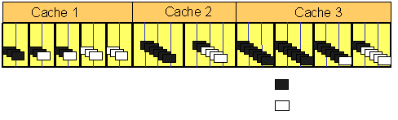
The Slab Allocator Components
Cache
  A store of recently used objects of the same type
Slab
  A container for objects and is made up of one or more page frames
  A cache consists of a number of slabs
Object
  The basic unit that resides in a slab
http://i30www.ira.uka.de/teaching/coursedocuments/109/lecturenotes/11/4/4/11-4-4-a.gif
allocated object
page frame
slabs
free object

Slide 44
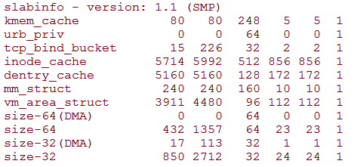
/proc/slabinfo
Understanding the Linux Virtual Memory Manager
num-active-objs
cache-name
num-pages-per-slab
total-objs
obj-size
total-slabs
num-active-slabs

Slide 45
Cache Descriptor
mm/slab.c
struct kmem_cache {
struct array_cache *array[NR_CPUS];
struct kmem_list3 *nodelists[MAX_NUMNODES];
unsigned int flags;
unsigned int num;
unsigned int gfporder;
gfp_t gfpflags;
unsigned int colour_off;
struct kmem_cache *slabp_cache;
unsigned int slab_size;
unsigned int dflags;
const char *name;
struct list_head next;
};
per-CPU array of pointers to local caches of free objects
…
contains the states of slabs
describes properties of the cache
# of objects packed into a slab
order of the # of page frames in a slab
flags when allocating page frames
basic alignment offset in the slabs
pointer to the cache containing
the slab descriptors
size of a single slab
…
describe dynamic properties of the cache
name of the cache
pointers for the doubly linked list of cache descriptors

Slide 46
Local Cache Descriptor
mm/slab.c
struct array_cache {
unsigned int avail;
unsigned int limit;
unsigned int batchcount;
unsigned int touched;
spinlock_t lock;
void *entry[0];
};
index of the first free slot in the cache
maximum number of pointers in the local cache
chunk size for local cache refill or emptying
set to 1 if the local cache has been recently used
Multiprocessor implementation
Most allocations and releases of slab objects affect the local cache only
The local cache is placed right after the descriptor

Slide 47
kmem_list3
mm/slab.c
doubly linked circular list of slab descriptors with both free and nonfree objects
struct kmem_list3 {
struct list_head slabs_partial;
struct list_head slabs_full;
struct list_head slabs_free;
unsigned long free_objects;
};
doubly linked circular list of slab descriptors with no free objects
…
doubly linked circular list of slab descriptors with free objects only
# of free objects in the cache

Slide 48
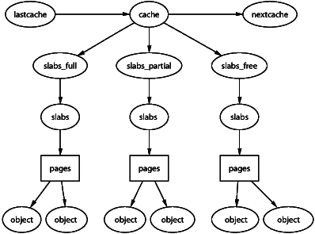
Slab Descriptor
mm/slab.c
struct slab {
struct list_head list;
unsigned long colouroff;
void *s_mem;
unsigned int inuse;
kmem_bufctl_t free;
unsigned short nodeid;
};
Understanding the Linux Virtual Memory Manager
list: slab_partial, slab_full,
or slab_free
colouroff: offset of the first object
in the slab
*s_mem: address of first object
inuse: # of objects in the slab
that are currently used
free: index of next free object
in the slab

Slide 49
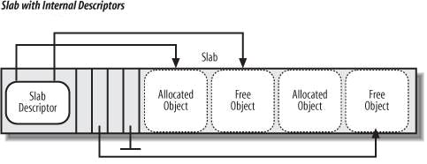
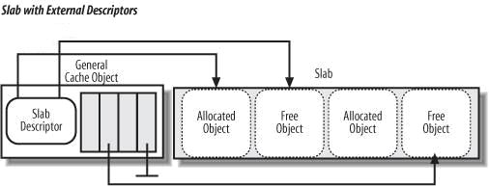
Object Descriptor
mm/slab.c
typedef unsigned int kmem_bufctl_t;
Simply an unsigned integer
Contains the index of the next free object in the slab
The object descriptor
of the last element
in the free object list
is marked by
BUFCTL_END
free
Understanding the Linux Kernel, 3rd Ed.
s_mem
BUFCTL_END
s_mem
free
BUFCTL_END

Slide 50
____cache_alloc()
mm/slab.c
allocate a slab object
static inline void *____cache_alloc(struct kmem_cache *cachep, gfp_t flags)
{
void *objp;
struct array_cache *ac;
check_irq_off();
if (should_failslab(cachep, flags)) return NULL;
ac = cpu_cache_get(cachep);
if (likely(ac->avail)) {
STATS_INC_ALLOCHIT(cachep);
ac->touched = 1;
objp = ac->entry[--ac->avail];
} else {
STATS_INC_ALLOCMISS(cachep);
objp = cache_alloc_refill(cachep, flags);
}
return objp;
}
interrupt should be disabled

Slide 51
____cache_alloc()
mm/slab.c
allocate a slab object
static inline void *____cache_alloc(struct kmem_cache *cachep, gfp_t flags)
{
void *objp;
struct array_cache *ac;
check_irq_off();
if (should_failslab(cachep, flags)) return NULL;
ac = cpu_cache_get(cachep);
if (likely(ac->avail)) {
STATS_INC_ALLOCHIT(cachep);
ac->touched = 1;
objp = ac->entry[--ac->avail];
} else {
STATS_INC_ALLOCMISS(cachep);
objp = cache_alloc_refill(cachep, flags);
}
return objp;
}
return cachep->array[smp_processor_id()];

Slide 52
____cache_alloc()
mm/slab.c
allocate a slab object
static inline void *____cache_alloc(struct kmem_cache *cachep, gfp_t flags)
{
void *objp;
struct array_cache *ac;
check_irq_off();
if (should_failslab(cachep, flags)) return NULL;
ac = cpu_cache_get(cachep);
if (likely(ac->avail)) {
STATS_INC_ALLOCHIT(cachep);
ac->touched = 1;
objp = ac->entry[--ac->avail];
} else {
STATS_INC_ALLOCMISS(cachep);
objp = cache_alloc_refill(cachep, flags);
}
return objp;
}
gets the address of the last-freed object and decreases the value of ac->avail

Slide 53
____cache_alloc()
mm/slab.c
allocate a slab object
static inline void *____cache_alloc(struct kmem_cache *cachep, gfp_t flags)
{
void *objp;
struct array_cache *ac;
check_irq_off();
if (should_failslab(cachep, flags)) return NULL;
ac = cpu_cache_get(cachep);
if (likely(ac->avail)) {
STATS_INC_ALLOCHIT(cachep);
ac->touched = 1;
objp = ac->entry[--ac->avail];
} else {
STATS_INC_ALLOCMISS(cachep);
objp = cache_alloc_refill(cachep, flags);
}
return objp;
}
repopulates the local cache and get a free object

Slide 54
__cache_free()
mm/slab.c
release an obj back to its cache
static inline void __cache_free(struct kmem_cache *cachep, void *objp)
{
struct array_cache *ac = cpu_cache_get(cachep);
check_irq_off();
objp = cache_free_debugcheck(cachep, objp, __builtin_return_address(0));
if (cache_free_alien(cachep, objp)) return;
if (likely(ac->avail < ac->limit)) {
STATS_INC_FREEHIT(cachep);
ac->entry[ac->avail++] = objp;
return;
} else {
STATS_INC_FREEMISS(cachep);
cache_flusharray(cachep, ac);
ac->entry[ac->avail++] = objp;
}
}
return 0; (useless)
the local cache has room for an additional pointer to a free object
adds the pointer to the local cache

Slide 55
__cache_free()
mm/slab.c
release an obj back to its cache
static inline void __cache_free(struct kmem_cache *cachep, void *objp)
{
struct array_cache *ac = cpu_cache_get(cachep);
check_irq_off();
objp = cache_free_debugcheck(cachep, objp, __builtin_return_address(0));
if (cache_free_alien(cachep, objp)) return;
if (likely(ac->avail < ac->limit)) {
STATS_INC_FREEHIT(cachep);
ac->entry[ac->avail++] = objp;
return;
} else {
STATS_INC_FREEMISS(cachep);
cache_flusharray(cachep, ac);
ac->entry[ac->avail++] = objp;
}
}
deplete the local cache
adds the pointer to the local cache

Slide 56
General Purpose Objects
Infrequent requests for memory areas are handled through a group of general caches
  Objects in these caches have geometrically distributed sizes ranging from 32 to 131,072 (2¹⁷) bytes
General purpose objects are obtained by kmalloc() and released by kfree()

Slide 57
The Call Graphs of kmalloc() & kfree()
kmalloc
kfree
__kmalloc
__cache_free
__do_kmalloc
__cache_alloc
____cache_alloc

Slide 58
The Layered Relationship
Slab Allocator
kmalloc()
kfree()
Zoned Allocator
alloc_pages()
__free_pages()
__rmqueue()
__free_one_page()
Buddy System
Physical Memory

Slide 59
Noncontiguous Memory Area
It’s not always possible to use contiguous memory allocation
Sometimes it’s more preferable to allocate noncontiguous page frames accessed through contiguous linear addresses
  Avoids external fragmentation
  Needs to manipulate the kernel Page Tables
The size of a noncontiguous memory area must be a multiple of 4,096

Slide 60
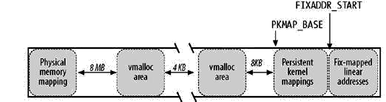
The 4th GB Linear Addresses
high_memory
PAGE_OFFSET
VMALLOC_START
VMALLOC_END
4GB
vm_struct
safety interval
VMALLOC_OFFSET
safety interval
reserved for noncontiguous memory areas

Slide 61
Noncontiguous Memory Area Descriptor
include/linux/vmalloc.h
struct vm_struct {
struct vm_struct *next;
void *addr;
unsigned long size;
unsigned long flags;
struct page **pages;
unsigned int nr_pages;
unsigned long phys_addr;
};
pointer to next vm_struct structure
linear address of the first memory cell
size of the area plus safety interval
type of memory mapped
pointer to array of nr_pages pointers to page descriptors
# of pages filled by the area
mapping to the I/O shared memory of a hardware device

Slide 62
__vmalloc_area_node()
mm/vmalloc.c
allocate a noncontiguous memory area to the kernel
void *__vmalloc_area_node(struct vm_struct *area, gfp_t gfp_mask,
pgprot_t prot, int node)
{
struct page **pages;
unsigned int nr_pages, array_size, i;
nr_pages = (area->size - PAGE_SIZE) >> PAGE_SHIFT;
array_size = (nr_pages * sizeof(struct page *));
area->nr_pages = nr_pages;
if (array_size > PAGE_SIZE) {
pages = __vmalloc_node(array_size, gfp_mask, PAGE_KERNEL, node);
area->flags |= VM_VPAGES;
} else {
pages = kmalloc_node(array_size,
(gfp_mask & ~(__GFP_HIGHMEM | __GFP_ZERO)), node);
}
area->pages = pages;
the initial address of the noncontiguous memory area of the descriptor
# of pages needed for the area (safety interval excluded)
size of the page descriptors needed
…

Slide 63
__vmalloc_area_node()
mm/vmalloc.c
allocate a noncontiguous memory area to the kernel
void *__vmalloc_area_node(struct vm_struct *area, gfp_t gfp_mask,
pgprot_t prot, int node)
{
struct page **pages;
unsigned int nr_pages, array_size, i;
nr_pages = (area->size - PAGE_SIZE) >> PAGE_SHIFT;
array_size = (nr_pages * sizeof(struct page *));
area->nr_pages = nr_pages;
if (array_size > PAGE_SIZE) {
pages = __vmalloc_node(array_size, gfp_mask, PAGE_KERNEL, node);
area->flags |= VM_VPAGES;
} else {
pages = kmalloc_node(array_size,
(gfp_mask & ~(__GFP_HIGHMEM | __GFP_ZERO)), node);
}
area->pages = pages;
finds additional noncontiguous memory area for the array
allocates contiguous memory area for the array
…

Slide 64
__vmalloc_area_node()
mm/vmalloc.c
allocate a noncontiguous memory area to the kernel
if (!area->pages) {
remove_vm_area(area->addr);
kfree(area);
return NULL;
}
memset(area->pages, 0, array_size);
for (i = 0; i < area->nr_pages; i++) {
if (node < 0) area->pages[i] = alloc_page(gfp_mask);
else area->pages[i] = alloc_pages_node(node, gfp_mask, 0);
if (unlikely(!area->pages[i])) {
area->nr_pages = i;
goto fail;
}
}
if (map_vm_area(area, prot, &pages)) goto fail;
return area->addr;
}
no such area available
removes the vm_struct descriptor and release the area
initializes the pointers
fail:
vfree(area->addr);
return NULL;

Slide 65
__vmalloc_area_node()
mm/vmalloc.c
allocate a noncontiguous memory area to the kernel
if (!area->pages) {
remove_vm_area(area->addr);
kfree(area);
return NULL;
}
memset(area->pages, 0, array_size);
for (i = 0; i < area->nr_pages; i++) {
if (node < 0) area->pages[i] = alloc_page(gfp_mask);
else area->pages[i] = alloc_pages_node(node, gfp_mask, 0);
if (unlikely(!area->pages[i])) {
area->nr_pages = i;
goto fail;
}
}
if (map_vm_area(area, prot, &pages)) goto fail;
return area->addr;
}
allocate every page separately
fail:
vfree(area->addr);
return NULL;

Slide 66
__vmalloc_area_node()
mm/vmalloc.c
allocate a noncontiguous memory area to the kernel
if (!area->pages) {
remove_vm_area(area->addr);
kfree(area);
return NULL;
}
memset(area->pages, 0, array_size);
for (i = 0; i < area->nr_pages; i++) {
if (node < 0) area->pages[i] = alloc_page(gfp_mask);
else area->pages[i] = alloc_pages_node(node, gfp_mask, 0);
if (unlikely(!area->pages[i])) {
area->nr_pages = i;
goto fail;
}
}
if (map_vm_area(area, prot, &pages)) goto fail;
return area->addr;
}
allocation failed
release the noncontiguous memory area
fail:
vfree(area->addr);
return NULL;

Slide 67
__vmalloc_area_node()
mm/vmalloc.c
allocate a noncontiguous memory area to the kernel
if (!area->pages) {
remove_vm_area(area->addr);
kfree(area);
return NULL;
}
memset(area->pages, 0, array_size);
for (i = 0; i < area->nr_pages; i++) {
if (node < 0) area->pages[i] = alloc_page(gfp_mask);
else area->pages[i] = alloc_pages_node(node, gfp_mask, 0);
if (unlikely(!area->pages[i])) {
area->nr_pages = i;
goto fail;
}
}
if (map_vm_area(area, prot, &pages)) goto fail;
return area->addr;
}
update the kernel page table entries with the new interval of contiguous linear address
fail:
vfree(area->addr);
return NULL;

Slide 68
Allocating & Freeing Noncontiguous Areas
Noncontiguous memory areas are allocated by vmalloc( ) to the kernel and freed by vfree() from the kernel
vmalloc
vfree
__vmalloc
__vunmap
kfree
__free_page
__vmalloc_node
__free_pages
__vmalloc_area_node
kmalloc_node
kmalloc

Slide 69
Conclusion - Linux 2.6 Improvements
4-level paging model
  Introduced to fully support the x86_64 platform
Reverse mapping
  Greatly reduced the serious bottleneck with locating processes that map a page
Large pages (4MB/2MB)
  Favors applications that use considerably large amounts of memory (e.g. databases)

Slide 70
Conclusion - Linux 2.6 Improvements
Storing PTEs in high memory
  Freeing more of the low memory area for other kernel data structures; better utilization of low memory
Much better stability
  Memory management policies are largely improved by distributors
Increased portability
  Less architecture-dependant memory operations

Slide 71
References
Understanding the Linux Kernel, 3rd Edition
Understanding the Linux Virtual Memory Manager
The Linux Kernel Primer: A Top-Down Approach for x86 and PowerPC Architectures
The sildes from the previous course
http://docs.huihoo.com/gnu_linux/own_os/emm-ia32_2.htm
http://www.cs.washington.edu/homes/zahorjan/homepage/Tools/LinuxProjects/SysCall/mmlinux.html
http://my.execpc.com/~geezer/osd/mem/index.htm
http://www.cs.ccu.edu.tw:8080/~lhr89/linux-kernel/Physical%20Memory%20Management%20in%20Linux.pdf
http://www-128.ibm.com/developerworks/linux/library/l-mem26/
http://www.win.tue.nl/~aeb/linux/lk/lk-9.html
http://puggy.symonds.net/~abhi/files/mm/node1.html

